Slide 1
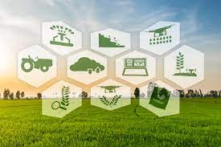
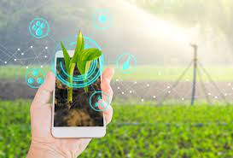
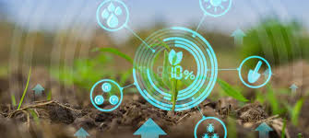
IoT Enabled Crop Monitoring [Make You Smart]
Presented By:
Punit Sharma
Vikas Shahu
Mohan Tare
Anushka Agrawal
Mentor:
Dr. Jaya Chandwani

Slide 2


Slide 3
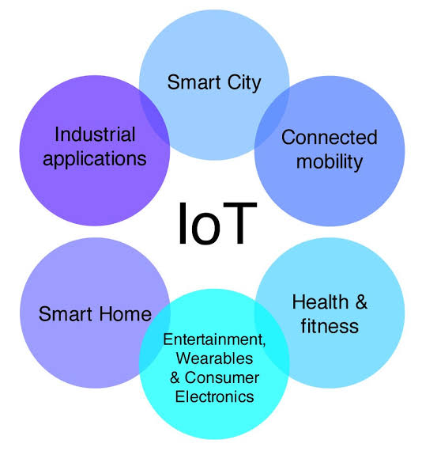
INTRODUCTION
The Internet of Things is simply an interaction between the physical and digital worlds. The digital world interacts with the physical world using a plethora of sensors and actuators. – Vermesan
The Internet of Things is defined as a paradigm in which computing and networking capabilities are embedded in any kind of conceivable object. – Peña-López

Slide 4
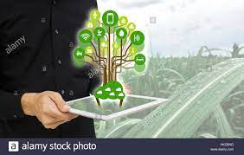
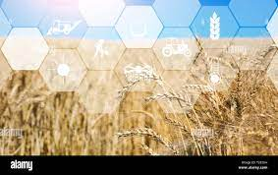
IoT in Agriculture
A system that is built for monitoring the crop field with the help of sensors and automating the irrigation system.
Enables growers and farmers to reduce waste and enhance productivity.
The farmers can monitor the field conditions from anywhere and also select between manual and automated options for taking necessary actions based on this data.

Slide 5
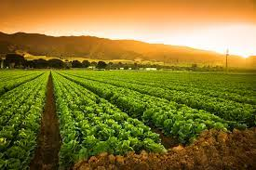
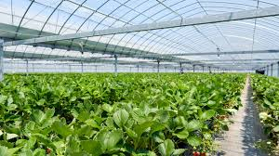
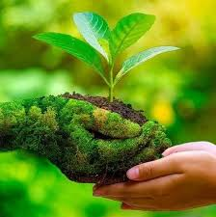
BENEFITS OF USING IoT IN CROP MONITORING
IoT system is made of sensors that enable us to take real-time weather conditions such as humidity, rainfall , temperature more accurately.
It helps us for optimization of resources.
Helps us to avoid all the challenges that may occur during farming process.
Increases productivity
Reduces labor
Helps us to use time efficiently
Helps to predict the growth.
Helps to predict weather conditions.
It generates alert messages, which notifies the farmer for any urgent conditions.

Slide 6
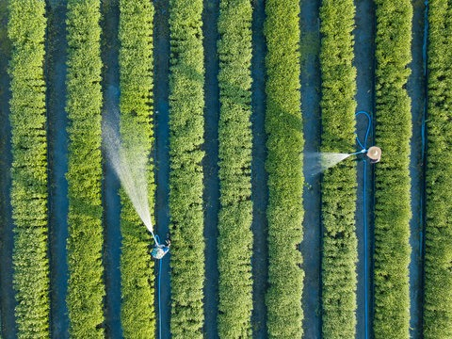
Problem Definition:
To create the crop monitoring system using IOT-enabled sensors for smart farming .
OBJECTIVES:
● To utilize the IOT kit (Arduino Uno) and interfacing it with various sensors(moisture, temperature, humidity).
● To sustainably increase the agricultural productivity and incomes.
● To make farms more connected and intelligent.
● To analyse the sensor data and provide information to the farmer.

Slide 7
Literature survey
1] Berlin-based agricultural tech startup PEAT has developed application called Plantix
I . Identifies potential defects nutrient deficiencies in soil.
II. Help client to sense soil’s strengths and weakness.
2] Chandankumar Sahu implemented the system with python programming in RASPBERRY-Pi
I. Control irrigation system and connect to internet.
II. Reduce wastage of water and human intervention.
3] Nelson Sales experimented with interconnection of smart objects embedded with sensors that enabled them to interact with the environment and among themselves, forming a Wireless Sensor Network (WSN)
I. Cloud Computing.
II. Decrease the water consumption, which would result in monetary and environmental benefits.

Slide 8
4] R. Balamurali et.al have discussed precision agriculture for real-time monitoring of environmental conditions
I. Use of different routing protocols.
II. Helps in precision agriculture using Wireless Sensor Network (WSN).
5] Elias Yaacoub et.al proposed the deployment of a wireless sensor network to monitor and analyze air quality in Doha
I. Results in user-friendly computation of an air quality index to broadcast the data to the general public.
II. Depending on the target end-user the stored data can be accessed and displayed in different formats.
6] Sky squirell technologies inc. Is one of the companies which brought Drone technology to vineyards.

Slide 9
7] Liu Dan et.al carried out experiments on intelligent agriculture greenhouse monitoring system based on ZigBee technology
I. Realize greenhouse environment system.
II. Reduce the money and farming cost and also save energy.
8] Greenhouse technology was started by Dr APJ Abdul Kalam with the help of Swaminathan. Started in LehLadakh to grow vegetables for the defence during extreme climatic conditions.
9] Precision Agriculture (PA) utilized WMSN(Wireless multimedia sensor network) to enable proficient irrigation.
I. Demonstrated the efficiency of feedback control technique in green house crop irrigation.

Slide 10
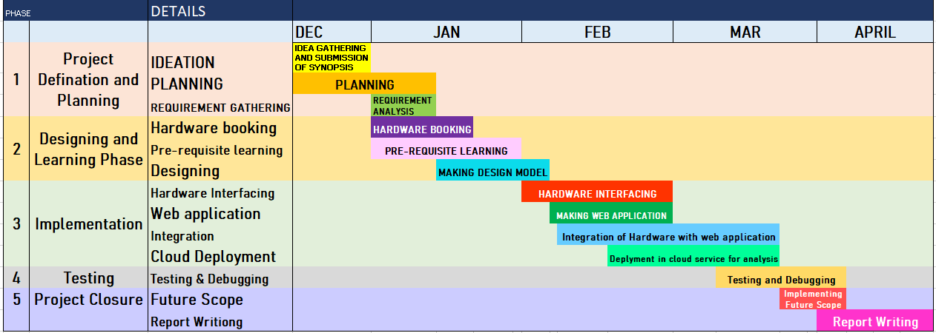

Slide 11

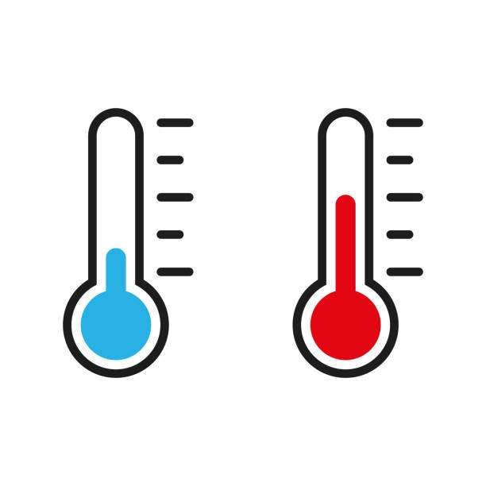
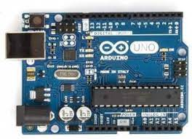
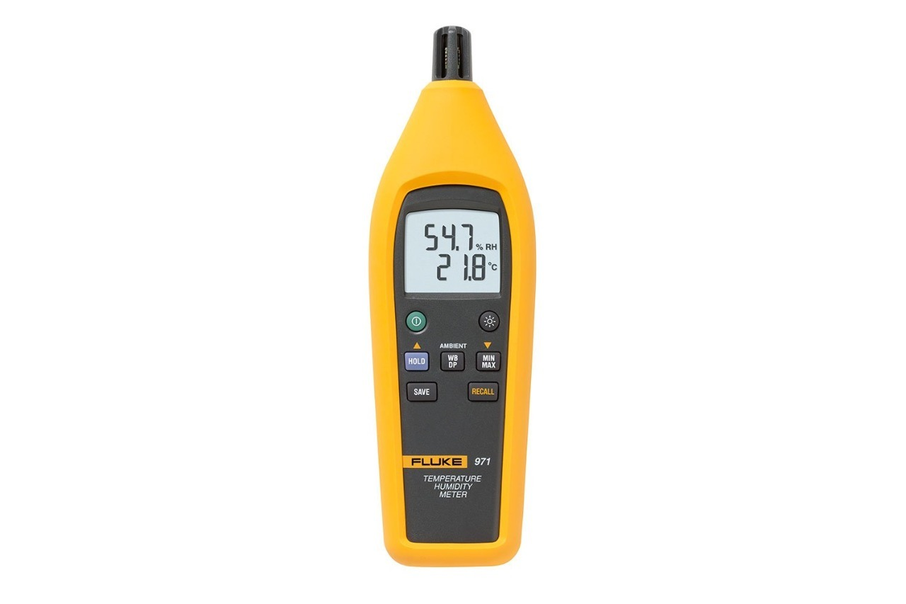
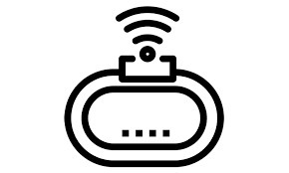
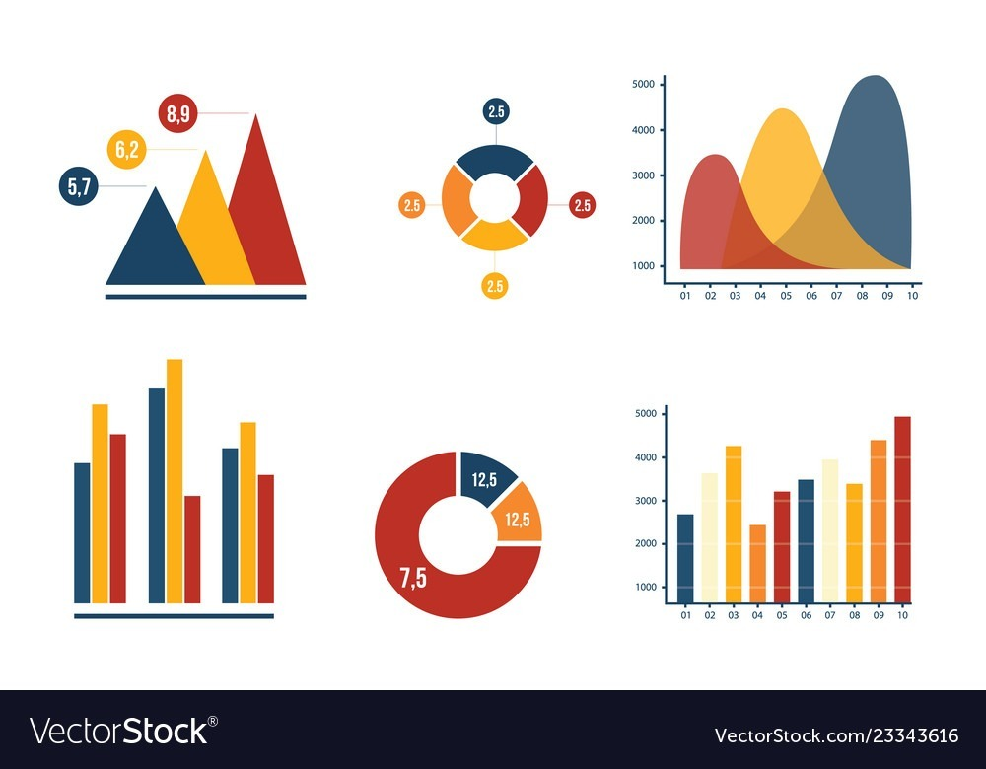

Functional Block Diagram:
IoT Technologies
Web technologies

Slide 12
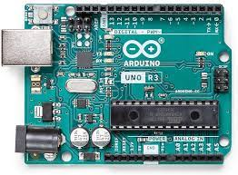
HARDWARE TO BE USED:
Arduino Uno Board
The Arduino Uno is an open-source microcontroller board based on the Microchip ATmega328P microcontroller and developed by Arduino.
Features of Arduino Uno
The operating voltage is 5V
The recommended input voltage will range from 7v to 12V
The input voltage ranges from 6v to 20V
Digital input/output pins are 14
Analog i/p pins are 6
DC Current for each input/output pin is 40 mA
DC Current for 3.3V Pin is 50 mA
Flash Memory is 32 KB
SRAM is 2 KB
EEPROM is 1 KB
CLK Speed is 16 MHz
AURDINO UNO
*EEPROM (electrically erasable programmable read-only memory) is user-modifiable read-only memory (ROM) that allow users to erase and reprogram stored data repeatedly in an application
*Flash Memory is one category of Read only memory
*SRAM (static RAM) is random access memory (RAM) that retains data bits in its memory as long as power is being supplied
*CLK speed= The clock speed measures the number of cycles CPU executes per second

Slide 13
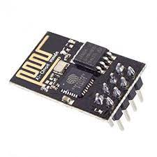
Contd…
ESP8266 WIFI MODULE
To transmit data to cloud we need internet connectivity.
Features of Esp8266 Wifi Module
UART-Wifi module and uses ultra-low power consumption technology
Supports standard IEEE802.11 b/g/n
Integrated TCP/IP protocol stack
Operating temperature range: -40 ° C ~ 125 ° C
Frequency range : 2.4GHz - 2.5GHZ
Operating voltage: 3.0v~3.6v
Operating current: Average value 80mA
Supports antenna diversity
WiFi 2.4 GHz, support WPA/WPA2 Security
Network protocol: IPv4, TCP/UDP/HTTP/FTP
Deep sleep power <10uA, Power-down leakage current < 5uA
Wake up and transmit packets in < 2ms
Esp8266 Wifi Module
*UART stands for Universal Asynchronous Receiver/Transmitter its main purpose is to transmit and receive serial data

Slide 14
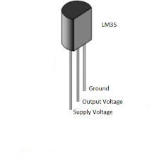
Contd…
TEMPERATURE SENSOR
LM35 can measure from -55 degrees centigrade to 150-degree centigrade.
Calculation
x° C = voltage got from voltage output pin (mill volt )/10(mill volt )
if the sensor is outputting 100 mills volt at vout pin the temperature in centigrade will be 10-degree centigrade
If the sensor is outputting -100 mills volt the temperature will be -10 degrees Celsius
LM35 Temperature sensor
Accuracy
PARAMETER | VALUE
Accuracy at 25° | ±0.5 °C
Accuracy from -55 °C to 150 °C | ±1 °C

Slide 15
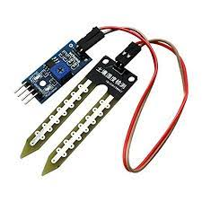
Contd...
It is used to measure the volumetric content of water within the soil.
This sensor mainly utilizes capacitance to measure the water content of the soil (dielectric permittivity). The working of this sensor can be done by inserting this sensor into the earth and the status of the water content in the soil can be reported in the form of a percent.
Features of Moisture sensor
The required voltage for working is 5V
The required current for working is <20mA
Type of interface is analog
The required working temperature of this sensor is 0°C~30°C
FC-28 soil moisture sensor
Soil Moisture Sensor Pin Configuration
VCC pin is used for power
A0 pin is an analog output
D0 pin is a digital output
GND pin is a Ground

Slide 16
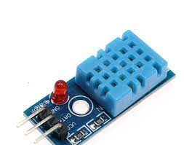
Contd…
Humidity Sensor
Humidity sensor measures the amount of water vapour in the air.
Features of DHt11 Humidity sensor
Ultra low cost
3 to 5V power and I/O
2.5mA max current use during conversion (while requesting data)
Good for 20-80% humidity readings with 5% accuracy
Good for 0-50°C temperature readings ±2°C accuracy
DHt11 Humidity Sensor

Slide 17
Software Includes:
FrontEnd : HTML , CSS , JAVASCRIPT
Database: MySql , PHP
Cloud : AWS

Slide 18
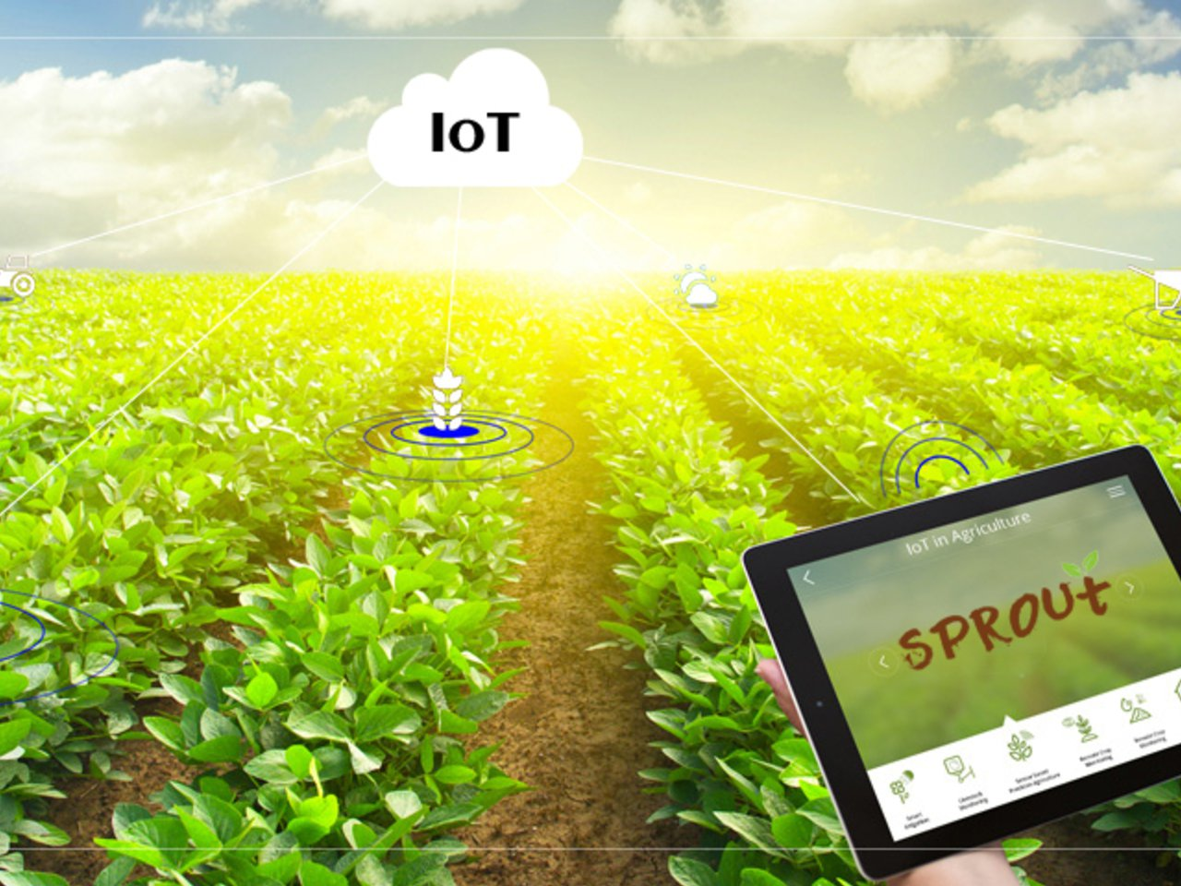
Methodology:
Step 1 : Connecting the hardware components and interfacing them with the Arduino Uno microcontroller.
Step 2 : Taking the real time data(like temperature, humidity and moisture) from surrounding using sensors.
Step 3 : Transferring the data from Arduino Uno to cloud using WiFI.
Step 4 : Applying the algorithms for data processing and analysing the data.
Step 5 : If the readings increase or decrease the limit values then sending the triggering warnings to the user and accordingly user will take action like turning on the water pump.
Step 6 : Displaying the data at user side with the help of graphs , tables etc.

Slide 19
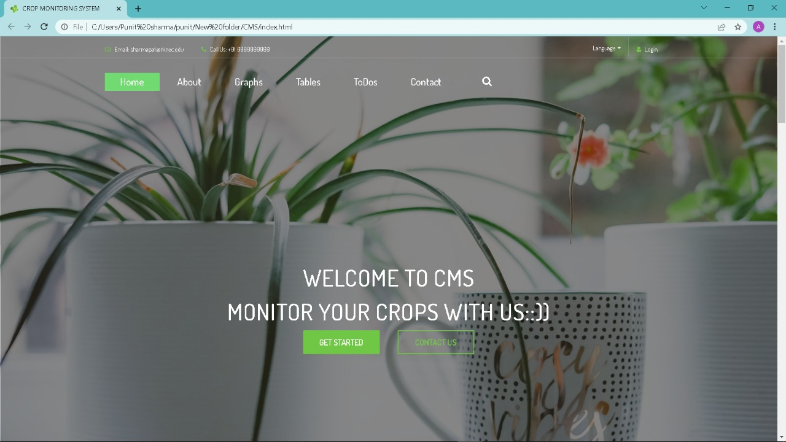
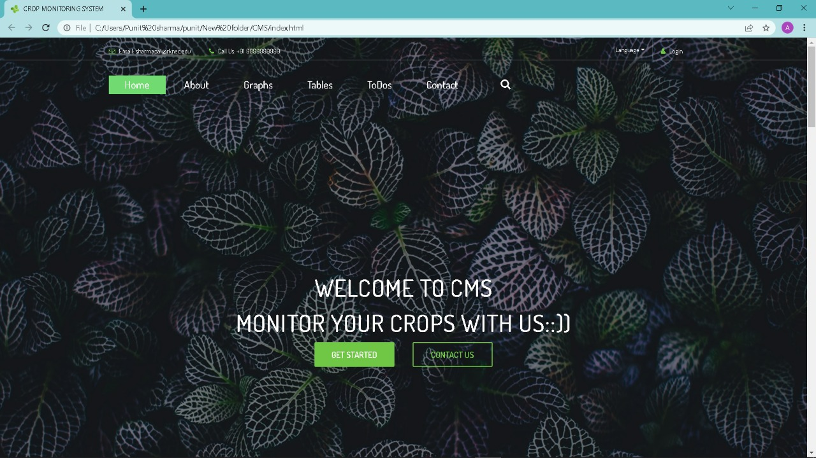
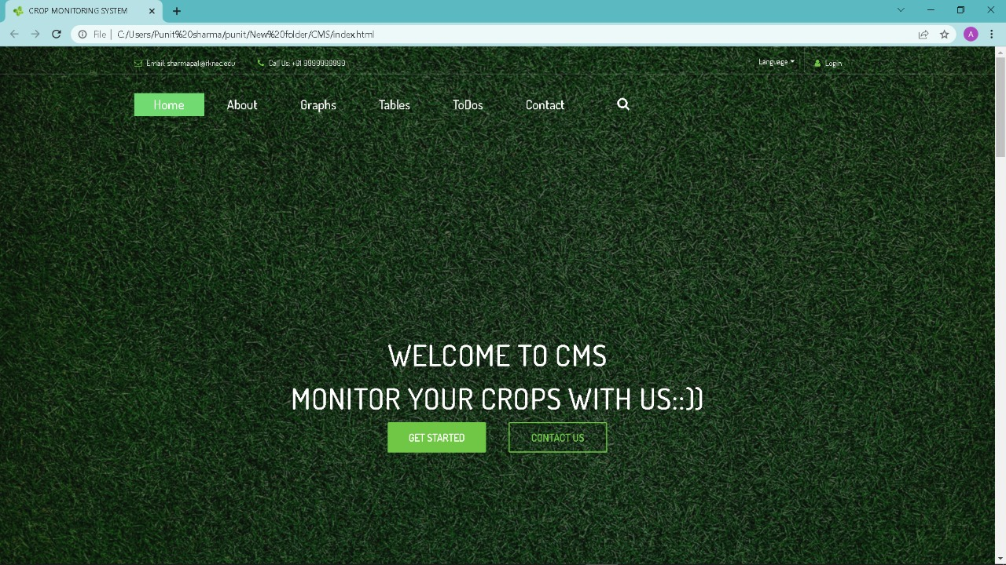
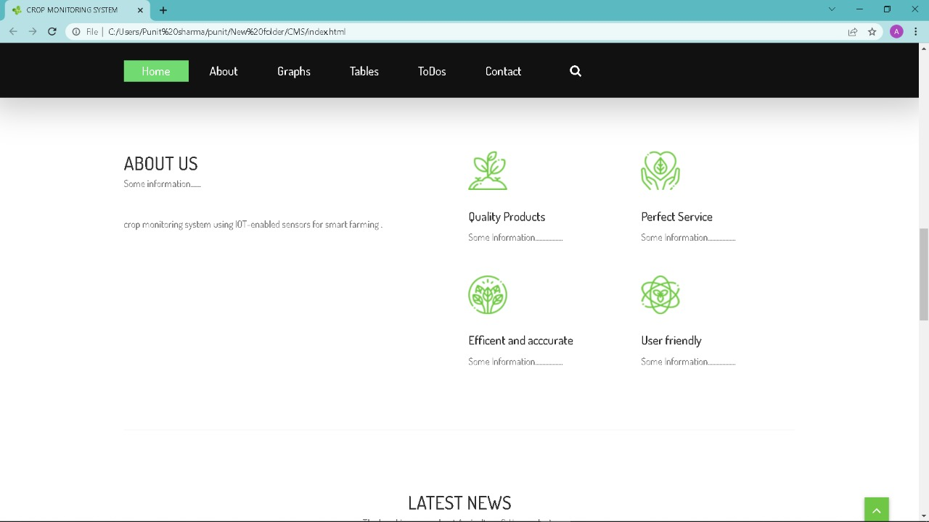
DEMO WEBSITE

Slide 20
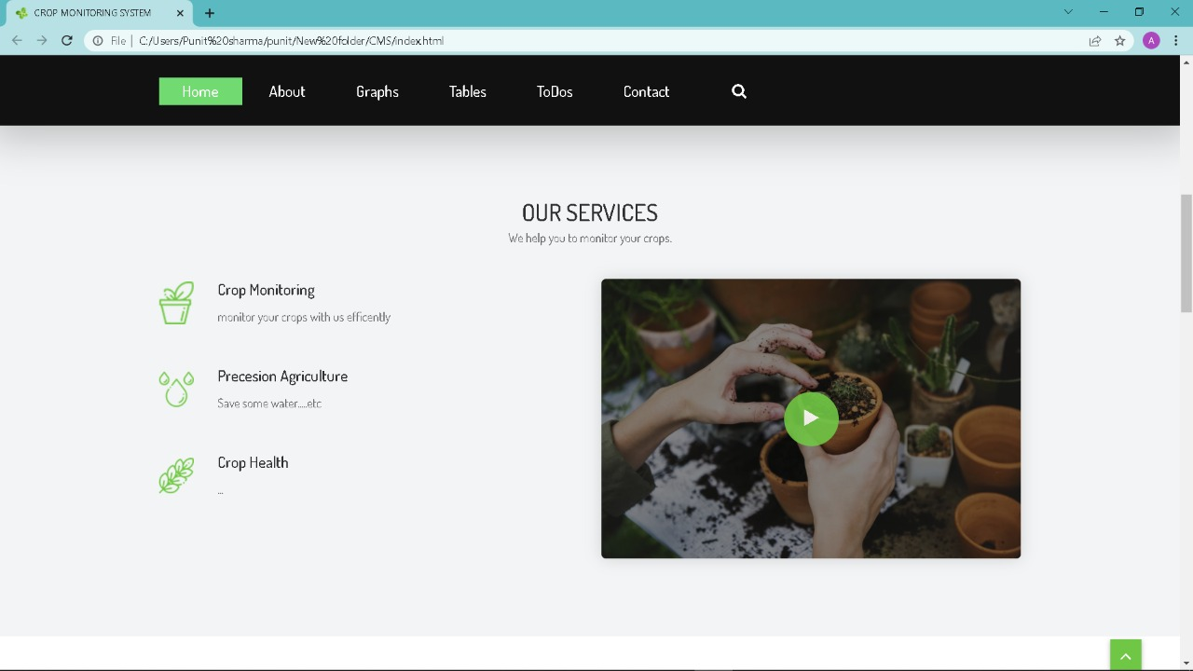
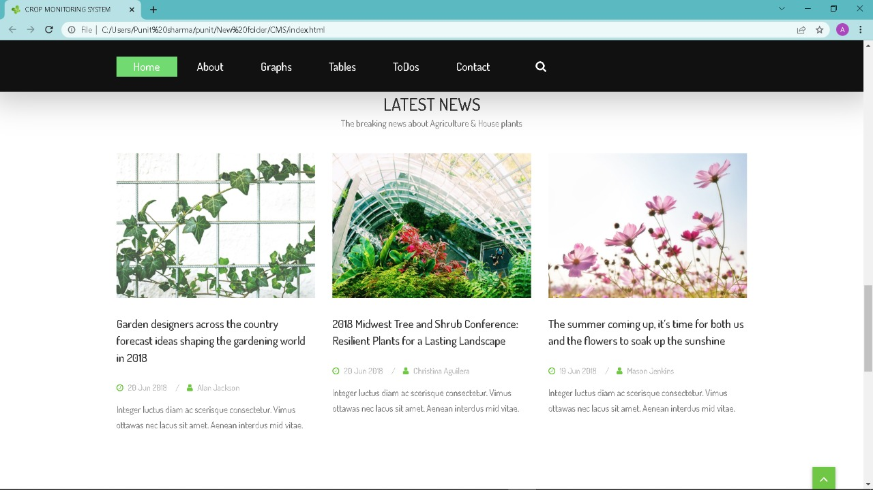
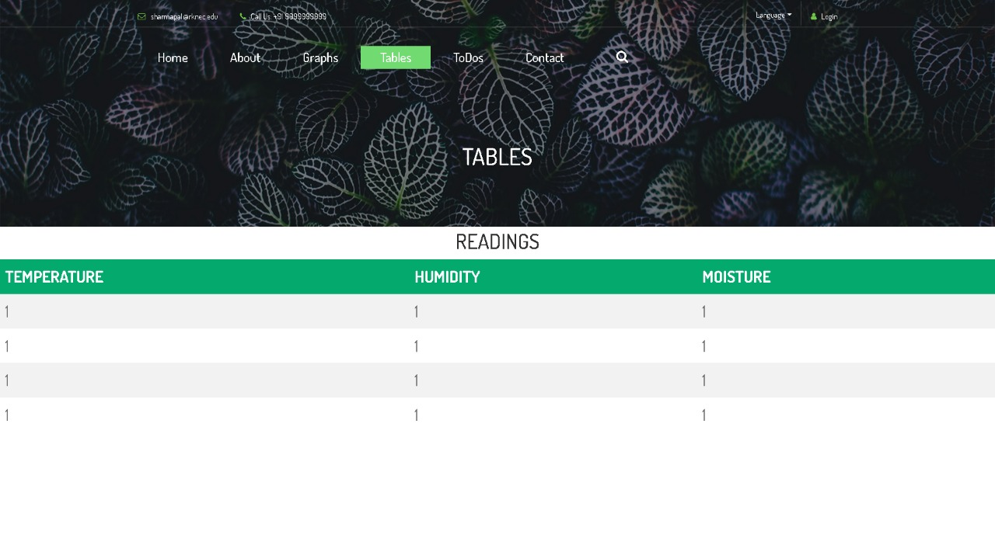
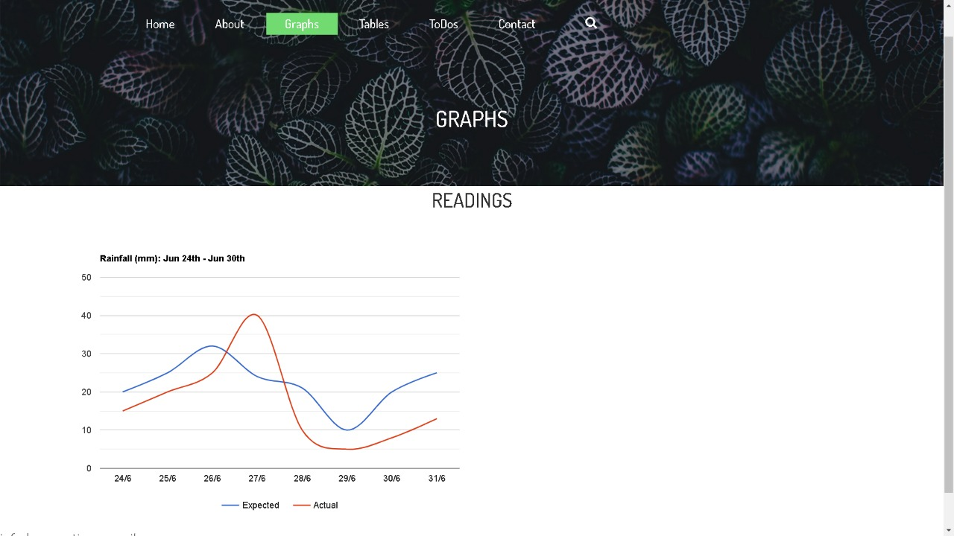
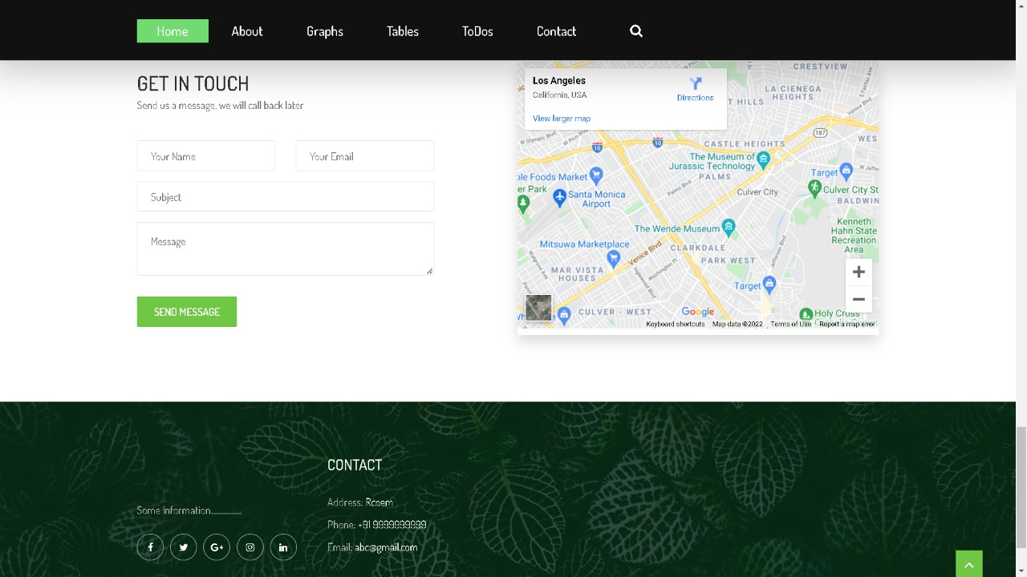
DEMO WEBSITE

Slide 21
Functional Specification[Deliverables]:
● Crop Monitoring: Developing prototype for real-time crop management.
● Maintaining a Record: Storing surrounding conditions over a period of time
● Data Preprocessing and analysis.
● Trigger Warnings: Displaying alerts if conditions are not within the normal limit.
● Hosting a Website: Provide a well-structured dashboard to use the system and display the analysed data.

Slide 22

Hardware Cost
Data Management
Literacy Rate
Connectivity
Interoperability
Data Analysis

Slide 23
DISADVANTAGES OF USING IoT for CROP MONITORING
High Cost
Lack of Security
Lack of infrastructure
Lack of better network quality
We don’t have highly educated farmers in our society

Slide 24
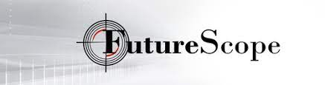

With adverse climatic conditions, an Indian farmer can’t predict and plan farming activities. Therefore, there is a dire need for a system that could provide precise and accurate information about crop cultivation needs.
We can apply the Iot to predict the environment and climate conditions and provide the data to farmers about types of crop that can be grown.
We can use Iot analytics to predict the types of crop that the farmers can grow that will help them best economically and give them maximum benefits.
Iot based crop monitoring helps to manage the time efficiently, hence they can focus on more individual development.

Slide 25
References: [1]AnjumAwasthi& S.R.N Reddy, “Monitoring for Precision Agriculture using Wireless Sensor Network-A Review”, Global Journal of Computer Science and Technology Network, Web &Security,ISSN: 0975-4350.Year 2013 [2] International Journal of Pure and Applied Mathematics Volume 119 No. 12 2018, 14327-14335 ISSN: 1314-3395 (on-line version) [3] International Journal of Innovative Research in Advanced Engineering (IJIRAE) ISSN: 2349-2163 Issue 05, Volume 6 (May 2019) [4]Barshe P.S.B and P.D.K. Chitre, “Agriculture System based on OntologyAgroSearch”, (IJETAE) International Journal of Emerging Technology and Advanced Engineering, vol. 2, no. 8, 2012. [5] Braun, R. Wichert, A. Kuijper, and D. W. Fellner, “A benchmarking model for sensors in smart environments,” in Ambient Intelligence: European Conference, (AmI '14), Eindhoven, The Netherlands, November 2014. Revised Selected Papers, E. Aarts, B. de Ruyter, P. Markopoulos et al., Eds., pp. 242–257, 2014 [6]InfantialRubala. J, D. Anitha, “Agriculture Field Monitoring using Wireless Sensor Networks to Improving Crop Production” International Journal of Engineering Science and Computing , March 2017. [7]Jianfa Xia, Zhengzhou Tang, Xiaoqiu Shi, Lei Fan, Huaizhong Li ,"An environment monitoring for precise agriculture, based on wireless sensors Network", IEEE, 2011

Slide 26
[8] Ramakrishnan, M. and Suchithra, M. "A Review on Semantic Web Service Discovery Algorithms." International Journal of Soft Computing Medwell Publishing (Pakistan) Volume: 8 Issue: 4 pp: 313-320 Year: 2013 SNIP: 0.496 SJR: 0.029 ISSN: 1816-9503. [9] Nikesh Gondchawar1, Prof. Dr. R. S. Kawitkar2 “IoT based Smart Agriculture” International Journal of Advanced Research in Computer and Communication Engineering ISSN 2319 5940 June 2016 [10] Rekha, S.MuthuSelvi, “Android Arduino Interface with Smart Farming System”, International Journal Of Engineering And Computer Science ISSN:2319-7242, March 2017

Slide 27
Thank You………

